Slide 1
Semantic Segmentation
Sungjoon Choi
Based on Hyeonwoo Noh’s slide

Slide 2
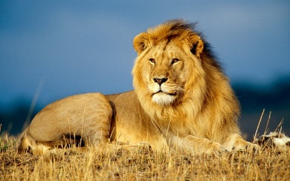
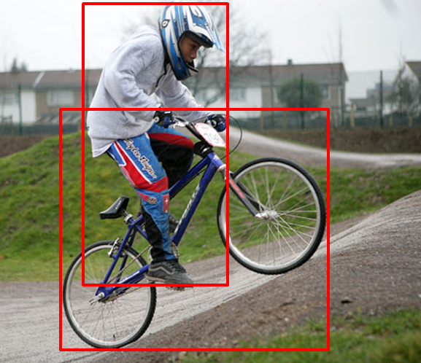
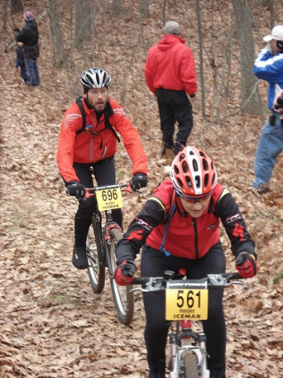
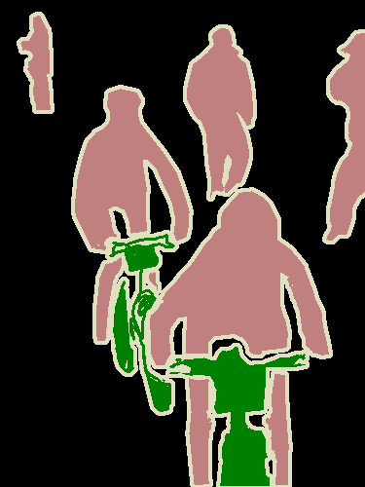
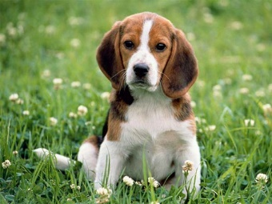
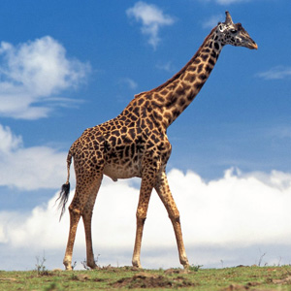
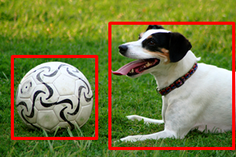
Semantic Segmentation?
lion
person
person
person
person
dog
bicycle
person
giraffe
person
ball
bicycle
bicycle
dog
Image Classification
Object Detection
Semantic Segmentation

Slide 3
Previous CNN based Works
Fully Convolutional Networks for Semantic Segmentation [FCN] [1]
Semantic Image Segmentation with Deep Convolutional Nets and Fully Connected CRFs [Deeplab-CRF] [2]
[1] J. Long, E. Shelhamer, and T. Darrell. Fully convolutional networks for semantic segmentation. In CVPR, 2015
[2] L.-C. Chen, G. Papandreou, I. Kokkinos, K. Murphy, and A. L. Yuille. Semantic image segmentation with deep convolutional nets and fully connected CRFs. In ICLR, 2015

Slide 4
Fully Convolutional Networks for Semantic Segmentation [FCN]
J. Long, E. Shelhamer, and T. Darrell. Fully convolutional networks for semantic segmentation. In CVPR, 2015

Slide 5
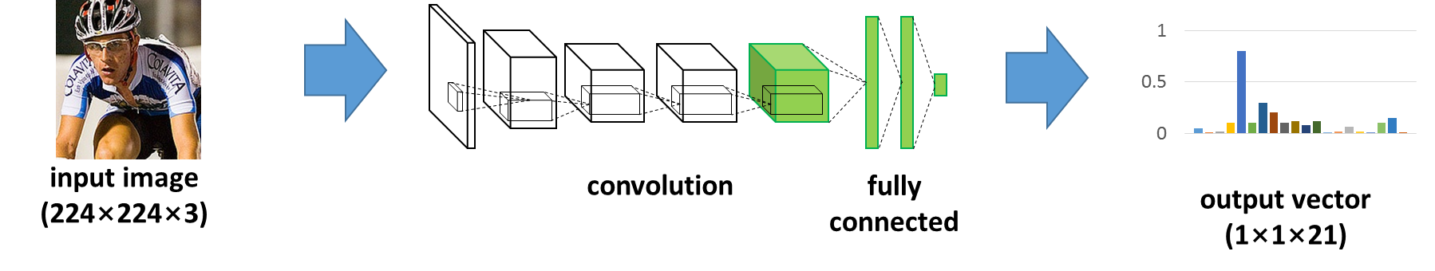
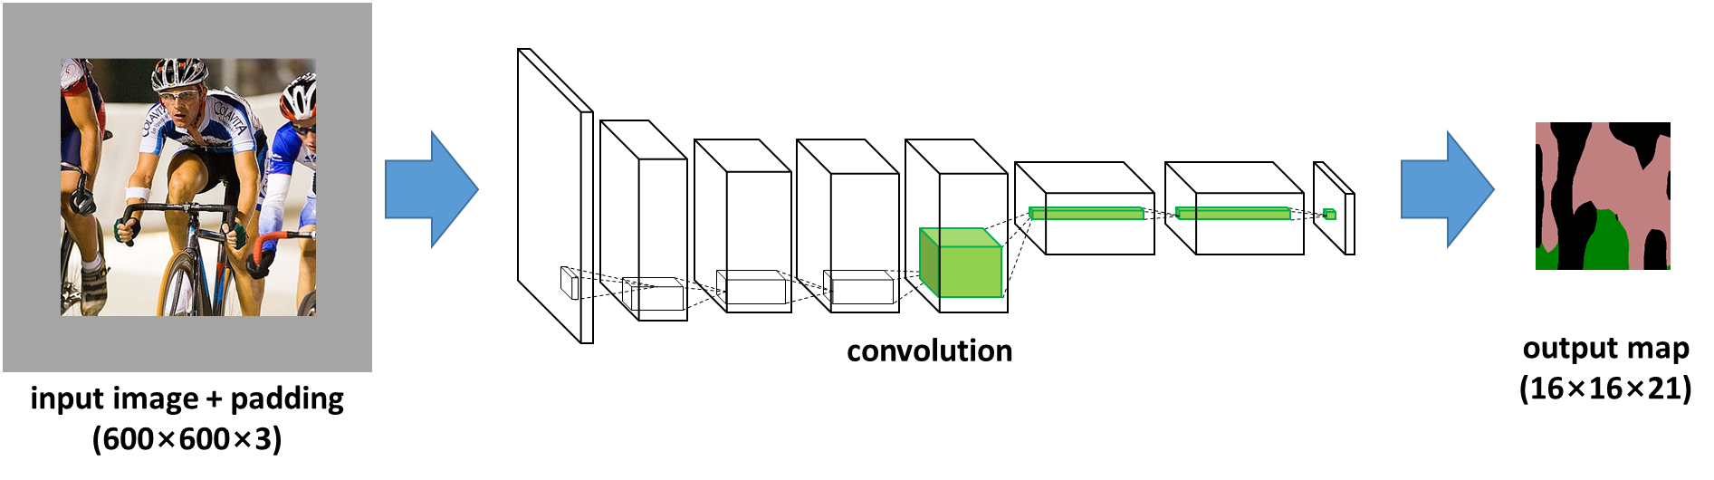
Approach
Apply classification CNN to large image with large padding
Classification CNN
FCN

Slide 6
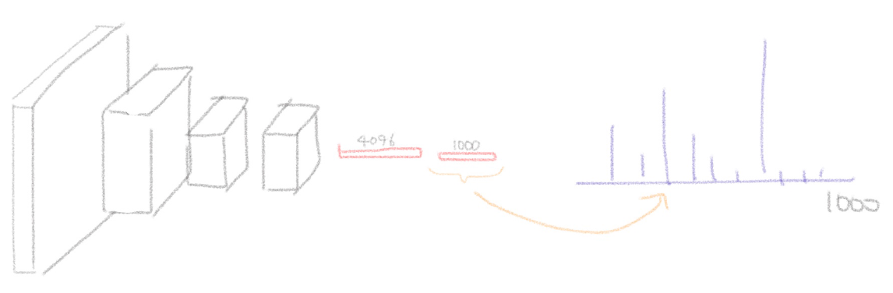
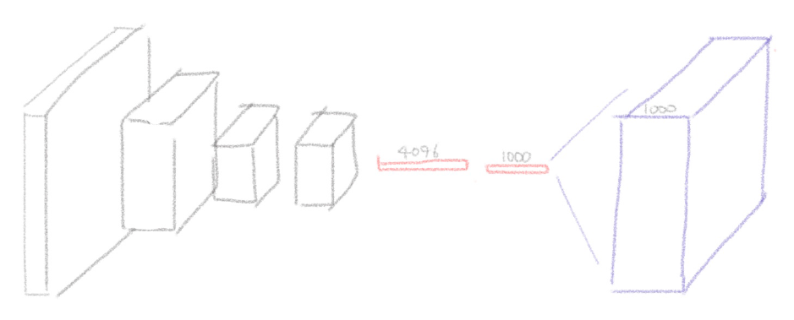
Approach

Slide 7
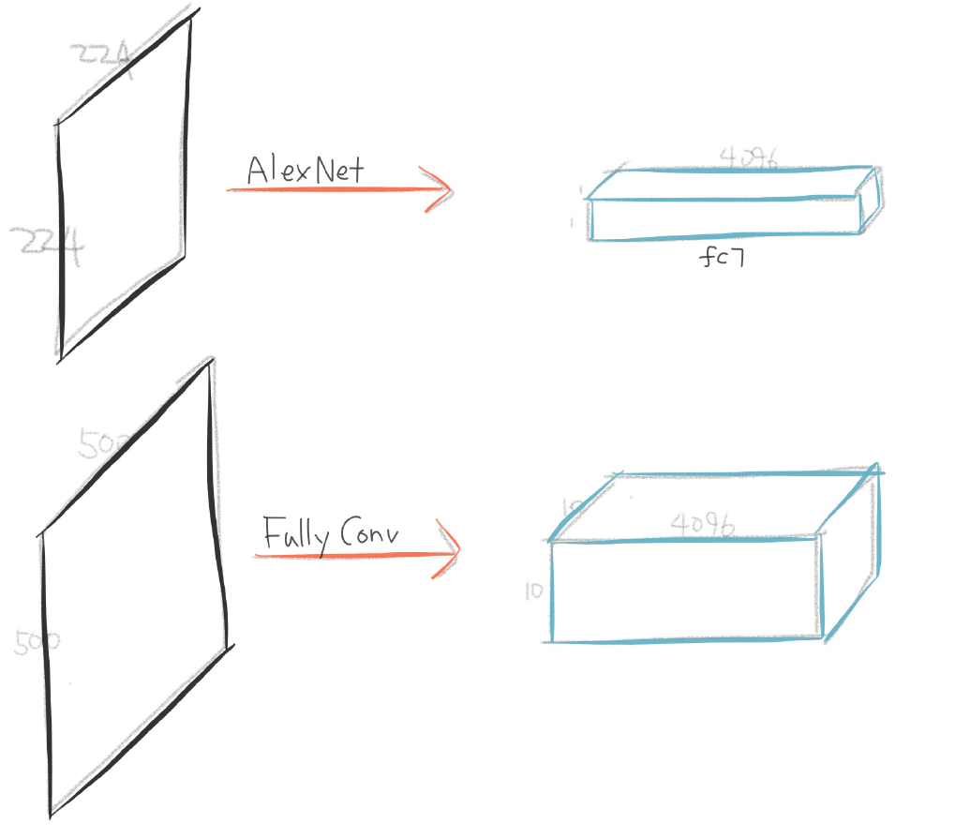
Fully Convolution?

Slide 8
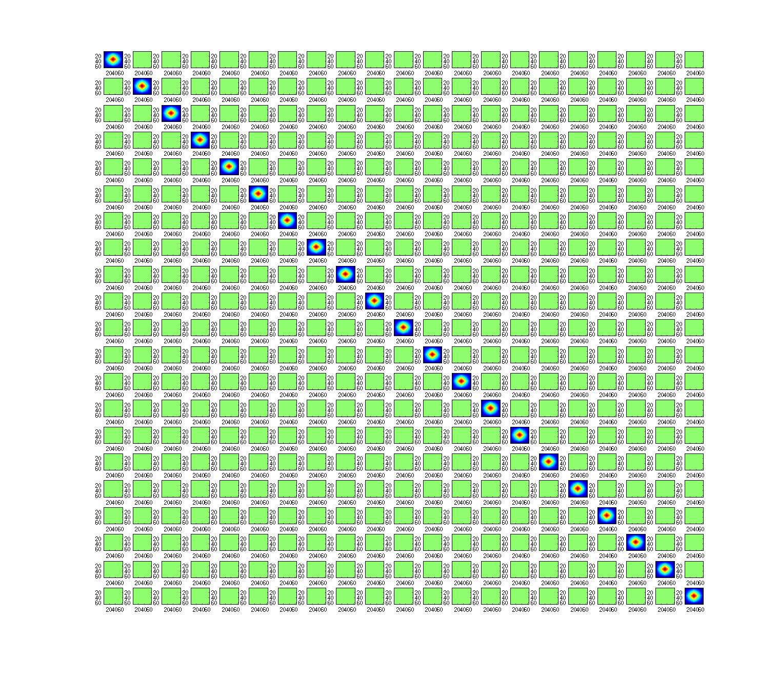
How to Obtain Higher Resolution Output
Single Deconvolution Layer with Large Stride
544
16
16
544
This deconvolution filter is initialized with bilinear weight
Equivalent to Bilinear Interpolation

Slide 9
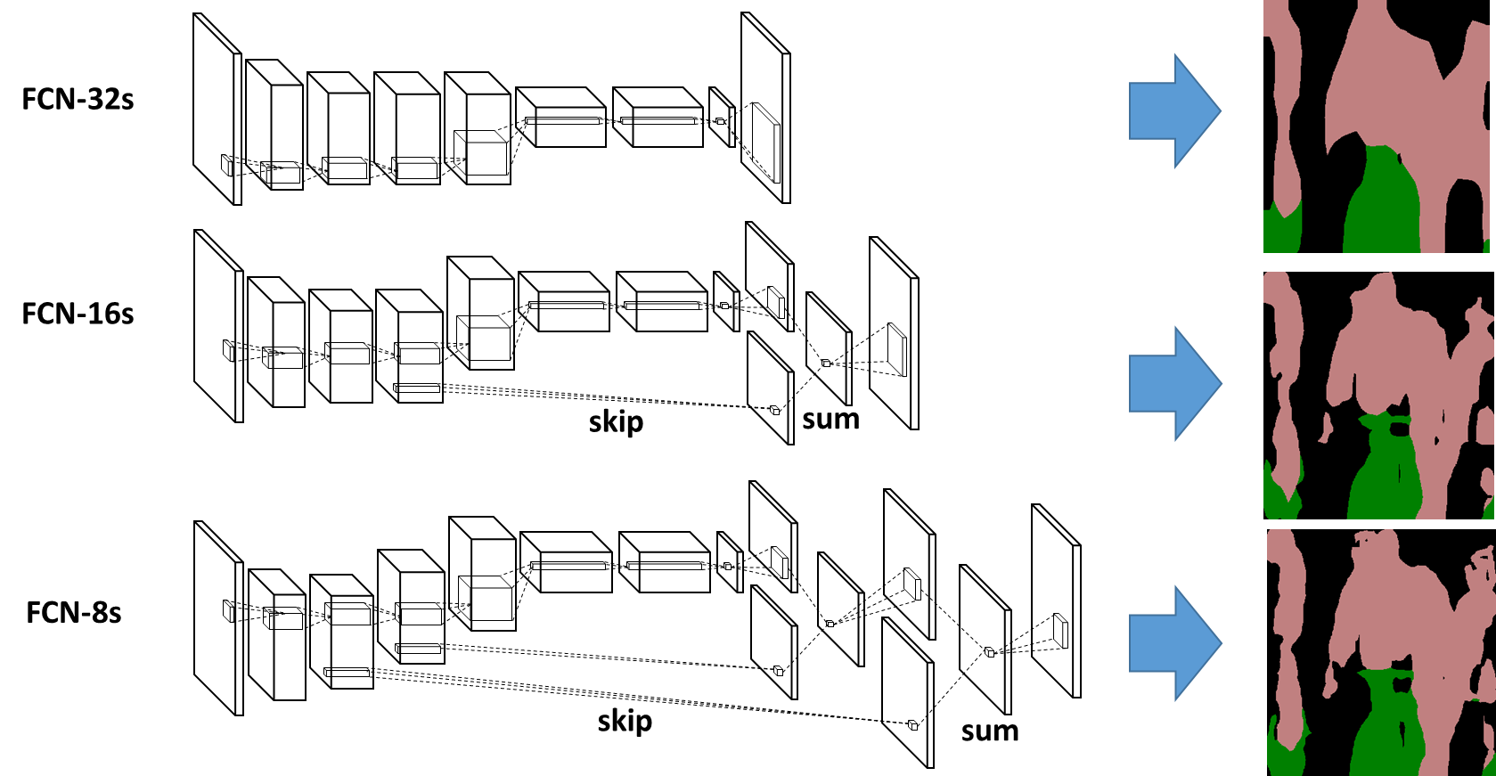
How to Obtain Higher Resolution Output
Skip Architecture
Pros: Low level feature are larger than high level feature spatially.
Cons: Low level feature are less discriminative

Slide 10
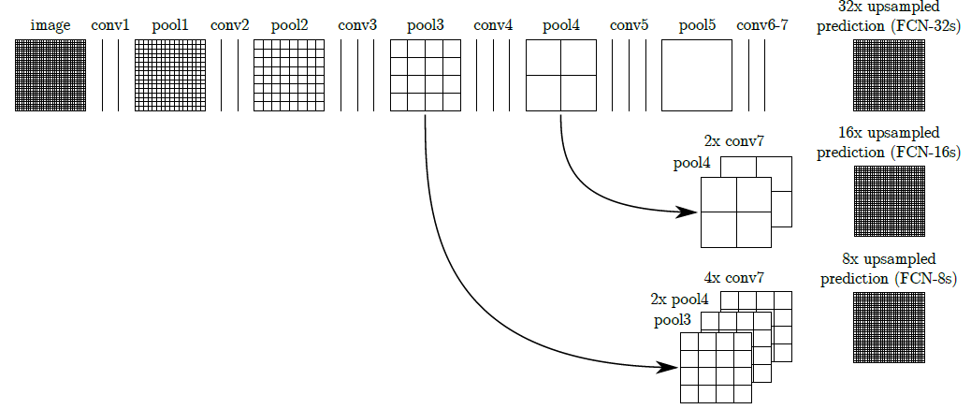
How to Obtain Higher Resolution Output

Slide 11
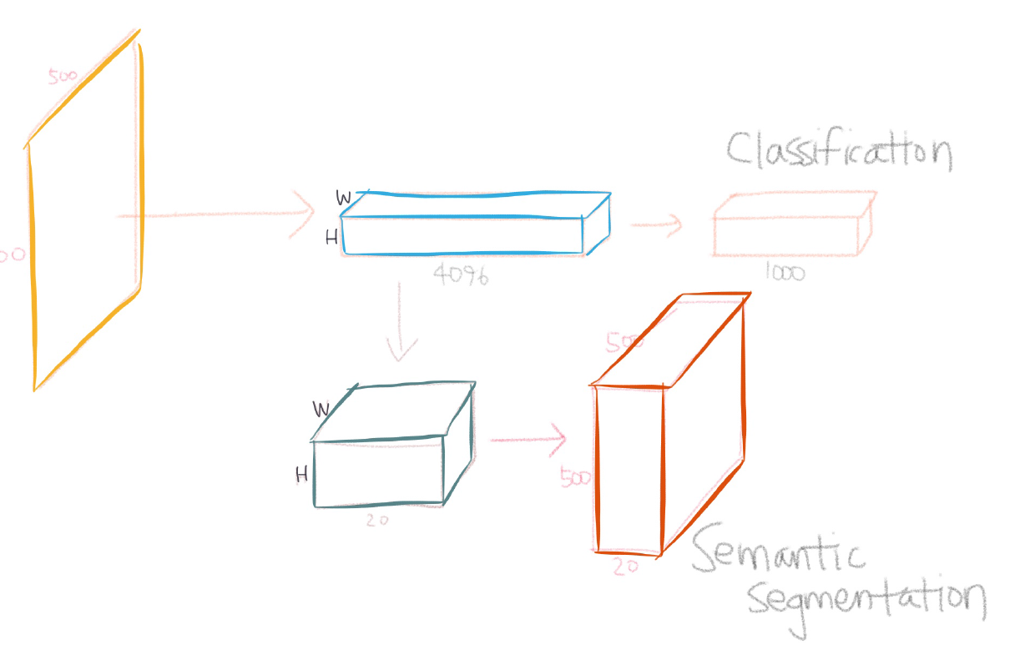
How to Obtain Higher Resolution Output

Slide 12
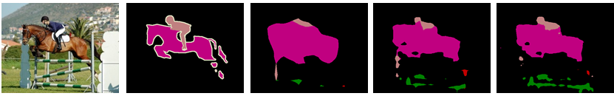
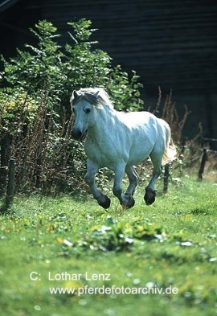




Limitations
Coarse output score maps
Skip architecture generate noisy predictions
Fixed receptive field size (cause label confusion)

Slide 13
Semantic Image Segmentation with Deep Convolutional Nets and Fully Connected CRFs [Deeplab-CRF]
L.-C. Chen, G. Papandreou, I. Kokkinos, K. Murphy, and A. L. Yuille. Semantic image segmentation with deep convolutional nets and fully connected CRFs. In ICLR, 2015

Slide 14
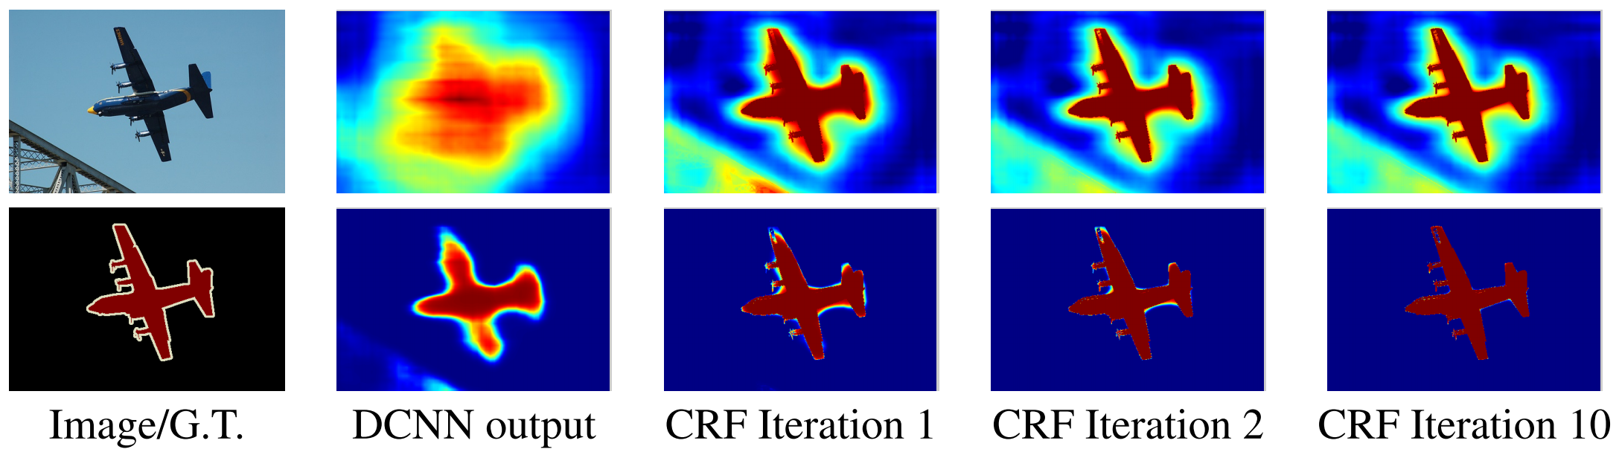
Approach
Better than FCN in two aspects
Produce denser output prediction using “Hole Algorithm”
CRF based post processing
Note:
this algorithm doesn’t use skip architecture
Simply upscale output score map without deconvolution layer

Slide 15
Conditional Random Field

Slide 16
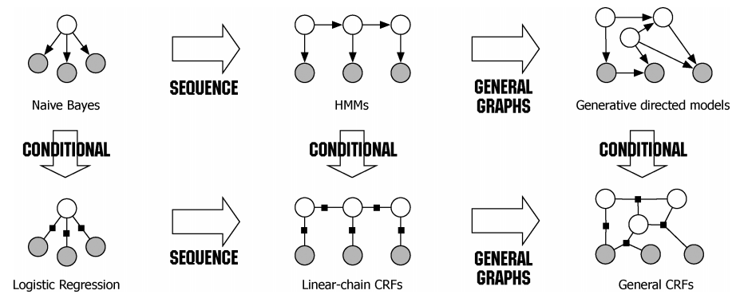
Conditional Random Field

Slide 17
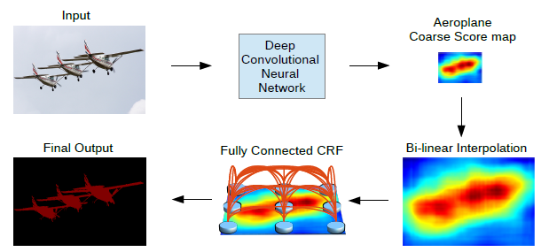
Approach

Slide 18
Hole Algorithm
Why output score map is smaller than input image?
Because of Pooling with stride
Removing Pooling? Pooling with no stride?
Make utilizing pre-trained CNN hard
Hole Algorithm Solves this problem
output
output
pool
pool
pool
pool
FCN with conventional Pooling
FCN with Hole Algorithm

Slide 19
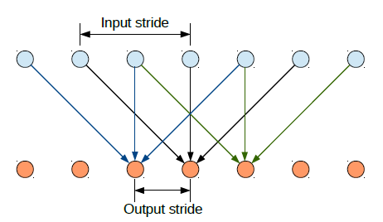
Hole Algorithm
Modify the convolutional filters in the layers that follow them by introducing zeros to increase their length (2x in the last three conv layers and 4x in the first conv layer)

Slide 20

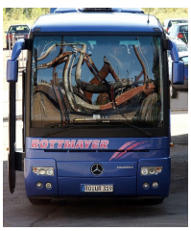
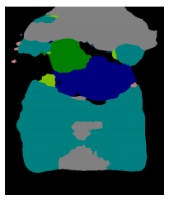
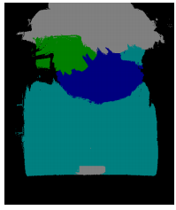
Limitations
Still coarse output score maps
Produce 39x39 output map from 306x306 input image
Fixed receptive field size (cause label confusion)

Slide 21
Learning Deconvolution Network for Semantic Segmentation
Hyeonwoo Noh, Seunghoon Hong, Bohyung Han

Slide 22
Our Approach
Deconvolution Network
CNN Architecture designed to generate large output
Enables dense output score prediction
Instance-wise prediction
Inference on object proposals, then aggregate
Enables recognition of objects with multiple scales

Slide 23
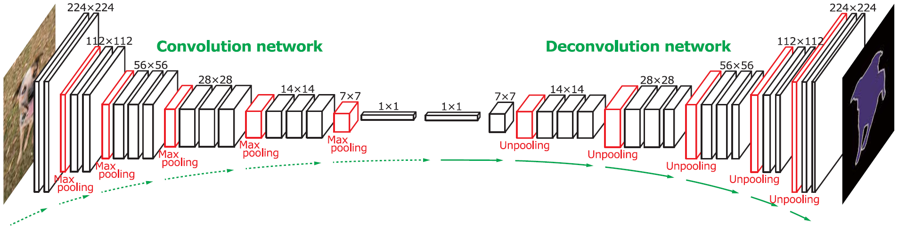
Deconvolution Network
Generate dense segmentation from fc7 feature representation
Multi-layer of deconvolution with relu non-linearity
Unpooling layer based upscaling

Slide 24
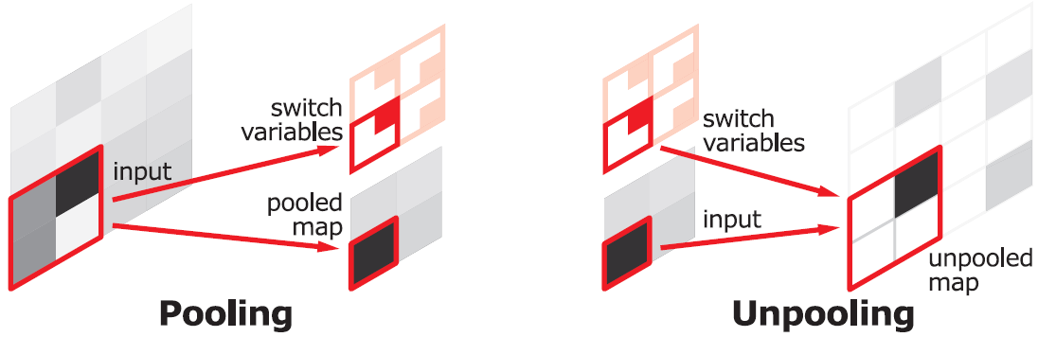
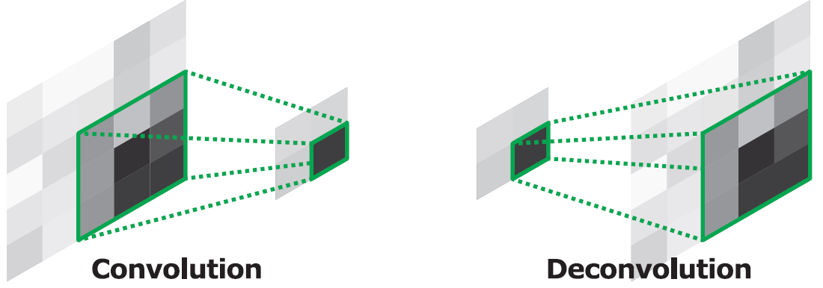
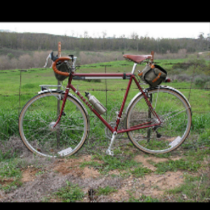
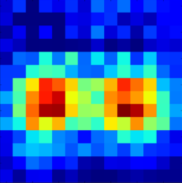
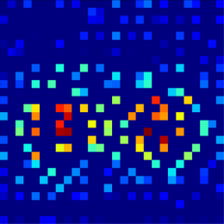
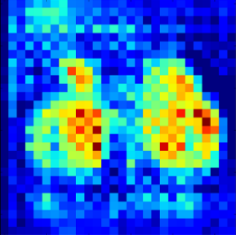
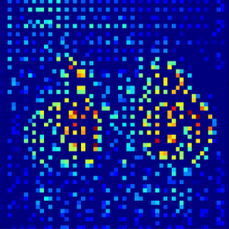
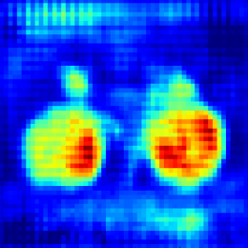
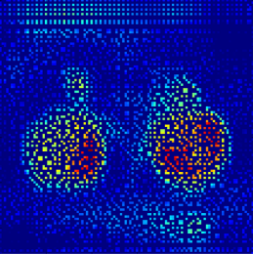
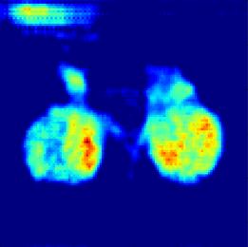
Deconvolution Network
Unpooling
Place activations to pooled location
Preserve structure of activations
Deconvolution
Densify sparse activations
Bases to reconstruct shape
input
forward propogation

Slide 25
Deconvolution Network
Training deconvolution network is difficult
Very deep network
Large output space
Batch Normalization [3]
Normalize input of every layer to standard Gaussian distribution
Prevent drastic change of input distribution in upper layers
Two stage training
First stage: training with object centered examples
Second stage: training with real object proposals
This approach make the network generalize better
[3] S. Ioffe and C. Szegedy. Batch normalization: Accelerating deep network training by reducing internal covariate shift. arXiv preprint arXiv:1502.03167, 2015.

Slide 26
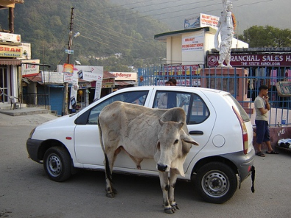
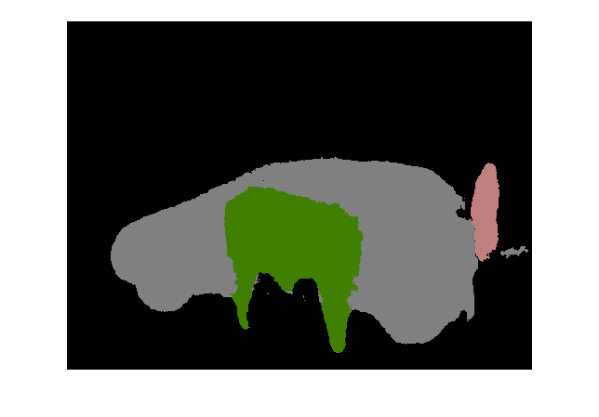


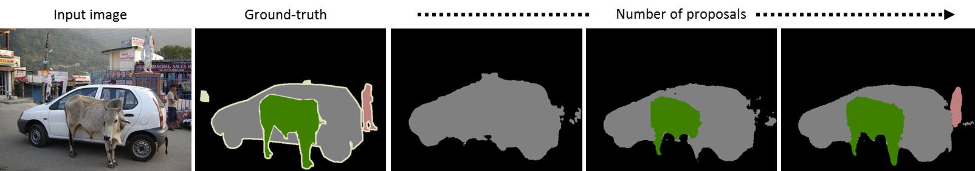
Instance-wise Prediction
Inference on object proposals, pixel-wise aggregation
Objects with multiple scale are detected in different proposals
DeconvNet
1. Input image
2. Object proposals
3. Prediction and aggregation
4. Results

Slide 27
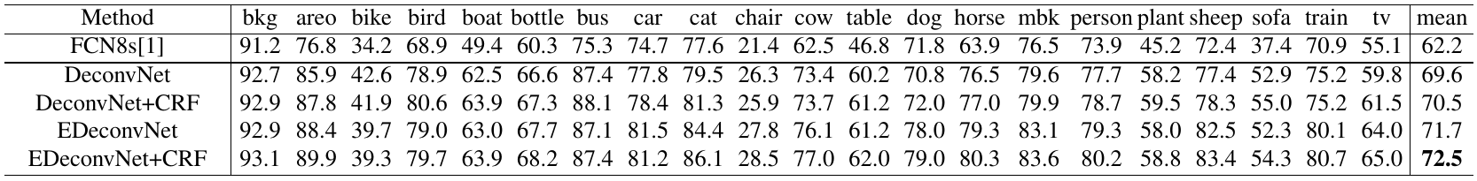
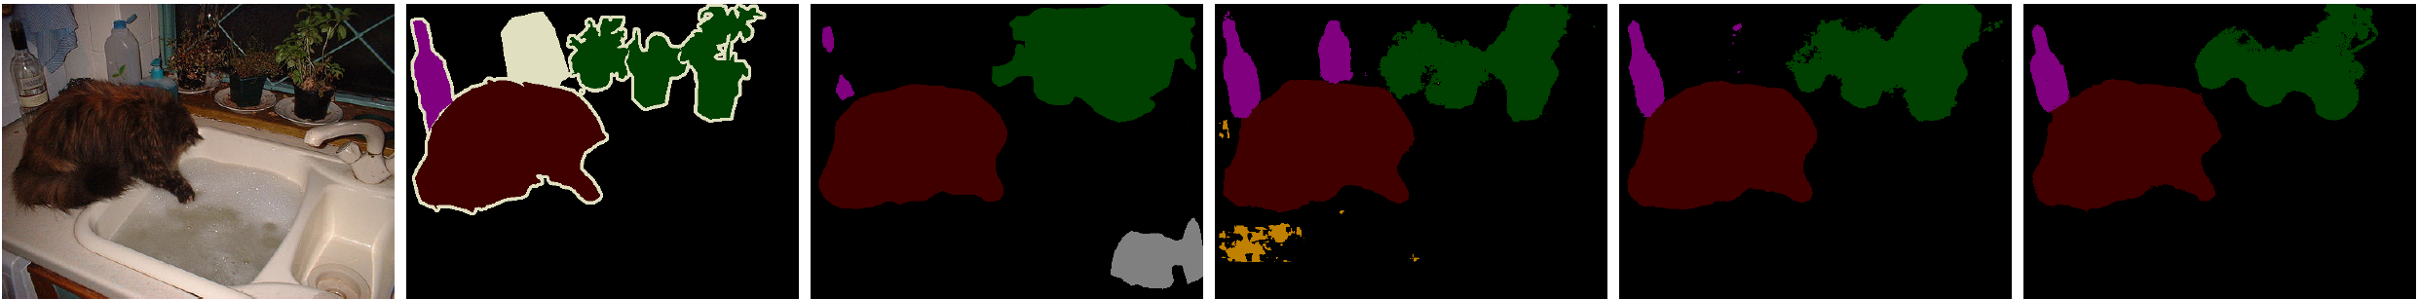
Further performance enhancement
Ensemble with FCN based model
FCN based models have complementary characteristic with ours
Ours: capture fine-detail, handle objects with various scales
FCN: capture context within image
Fully Connected CRF [4] based post-processing
[4] P. Krähenbühl and V. Koltun. Efficient inference in fully connected crfs with gaussian edge potentials. In NIPS, 2011.

Slide 28
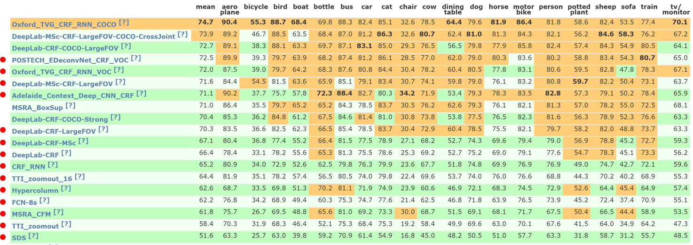
Quantitative Result
Best among the models trained with VOC2012 training data
VOC2012: 12,031 images
MSCOCO: 123,287 images

Slide 29
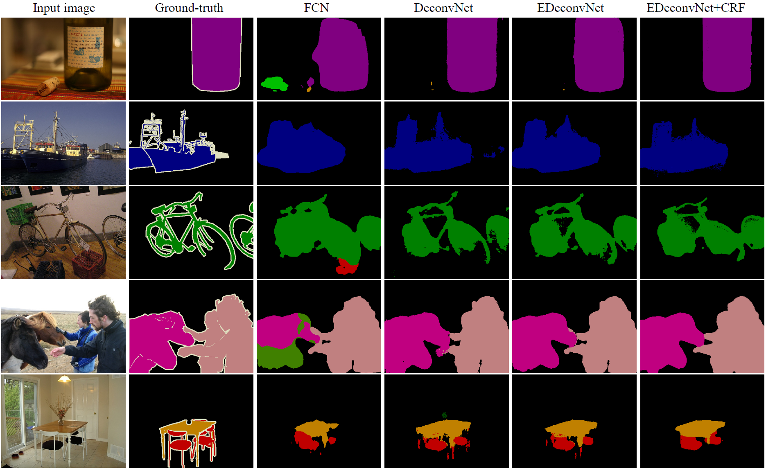
Qualitative Result

